Slide 1
Flashcard Web App
Adv. Front-End Programming
CPAN144-0NG
Liang Yu Tze, Ibrahim Sanni, Laurentino Martinez Iii
n01680521, n01704732,n01695662,

Slide 2
Purpose
- To create an interactive flashcard web app that helps users study and memorize information effectively.
- Allow users to create, view, and delete custom flashcards.
- Serve as a lightweight, easy-to-use learning aid for students.

Slide 3
Main Features and Functionality
- Create Cards: Add custom question-answer pairs.
- View Cards: Flip cards to test knowledge.
- Delete Cards: Remove cards you no longer need.
- Persistent Storage: Cards saved locally using localStorage.
- Responsive Design: Works on both desktop and mobile screens.
- Simple UI: Clean interface built with React components.

Slide 4
Challenges Encountered and Solutions
1. Flashcard Layout Issue
- Problem: Button stacked on top of cards.
- Solution: Used CSS Flexbox (display: flex; align-items: center;) to fix layout.
2. Data Persistence
- Problem: Flashcards disappeared on reload.
- Solution: Implemented localStorage to save and load cards.
3. Centering Buttons
- Problem: “Delete” button alignment was off.
- Solution: Wrapped button in a div and used justify-content: center.

Slide 5
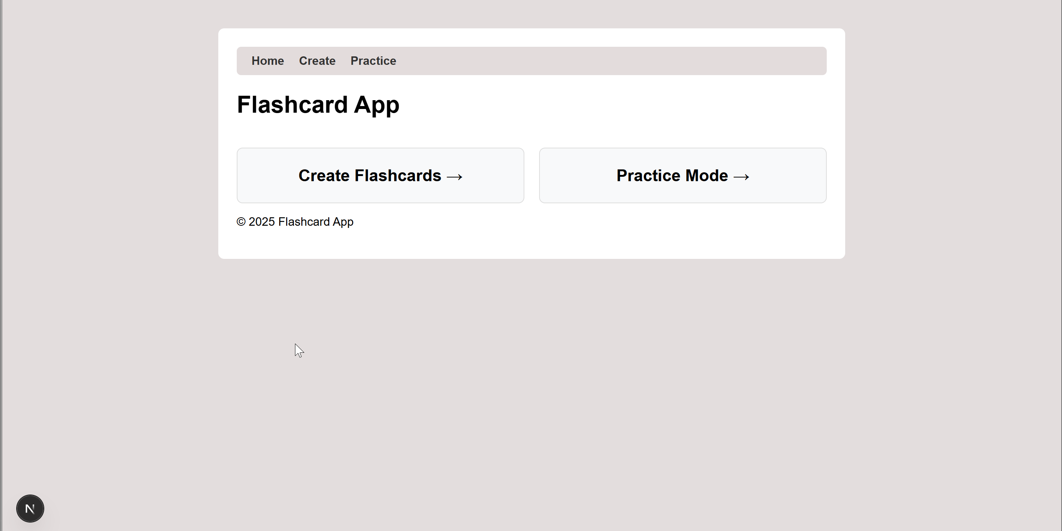
Demonstration of the Application

Slide 6
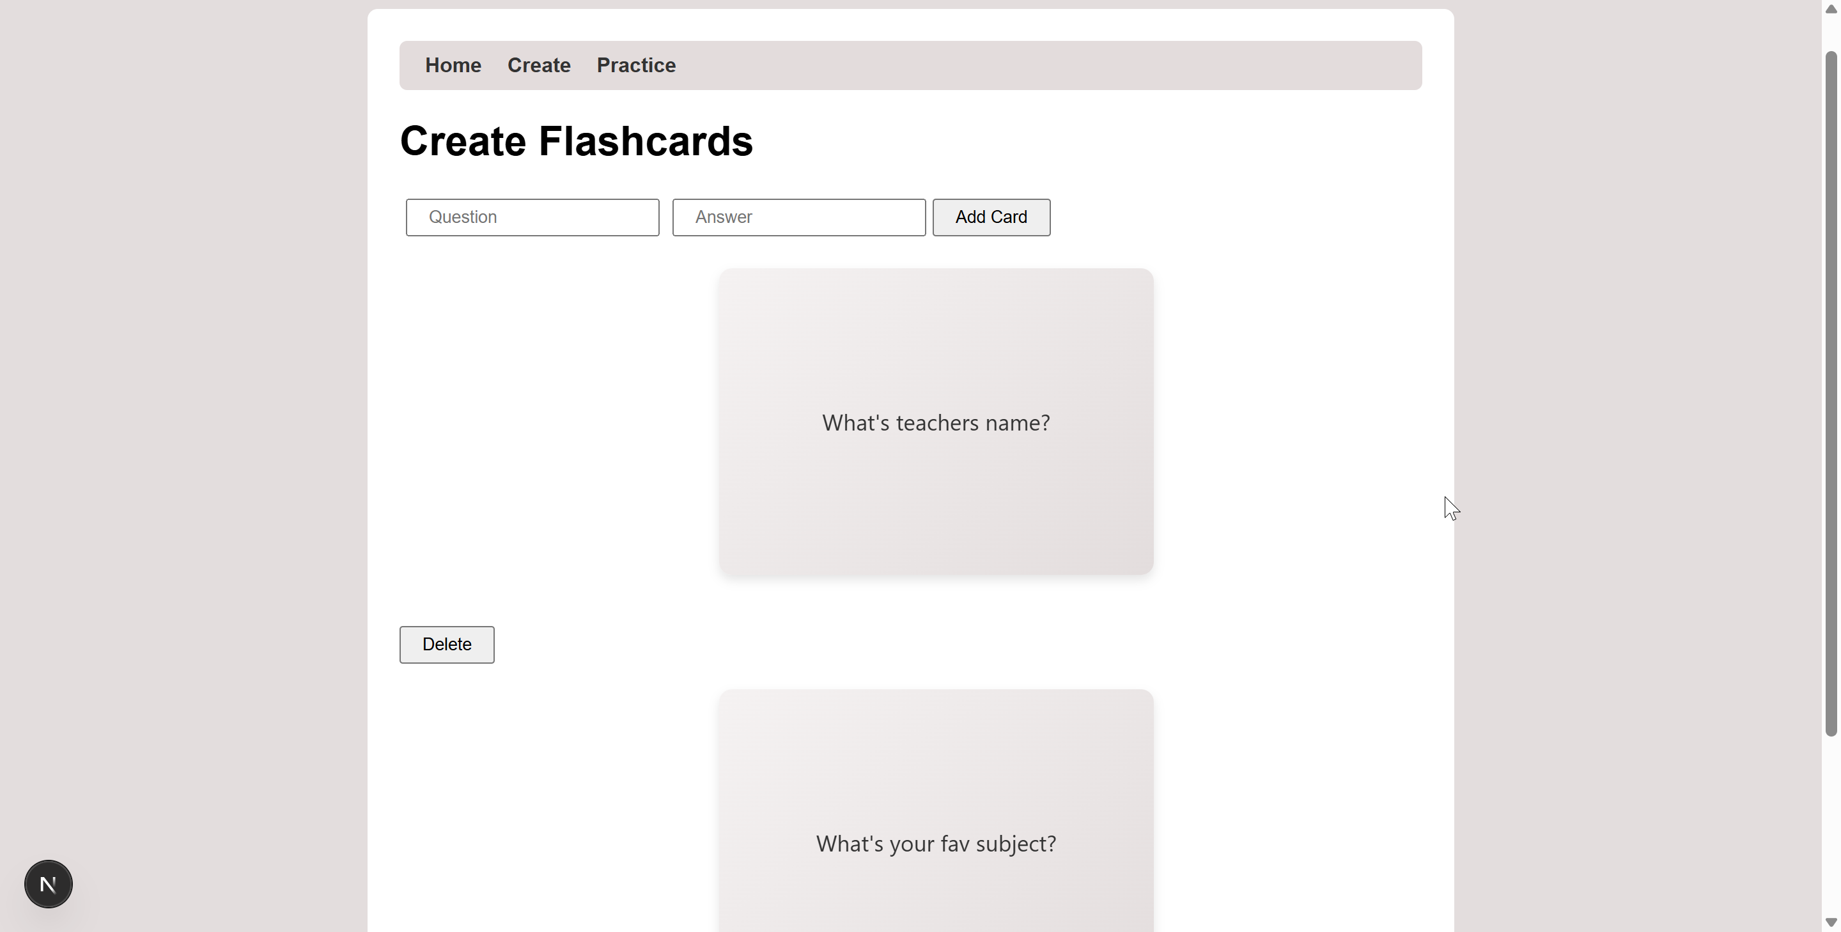
Create

Slide 7
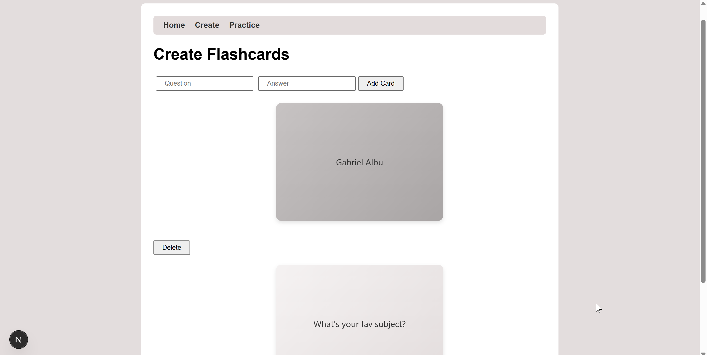
Flipped Flashcard

Slide 8
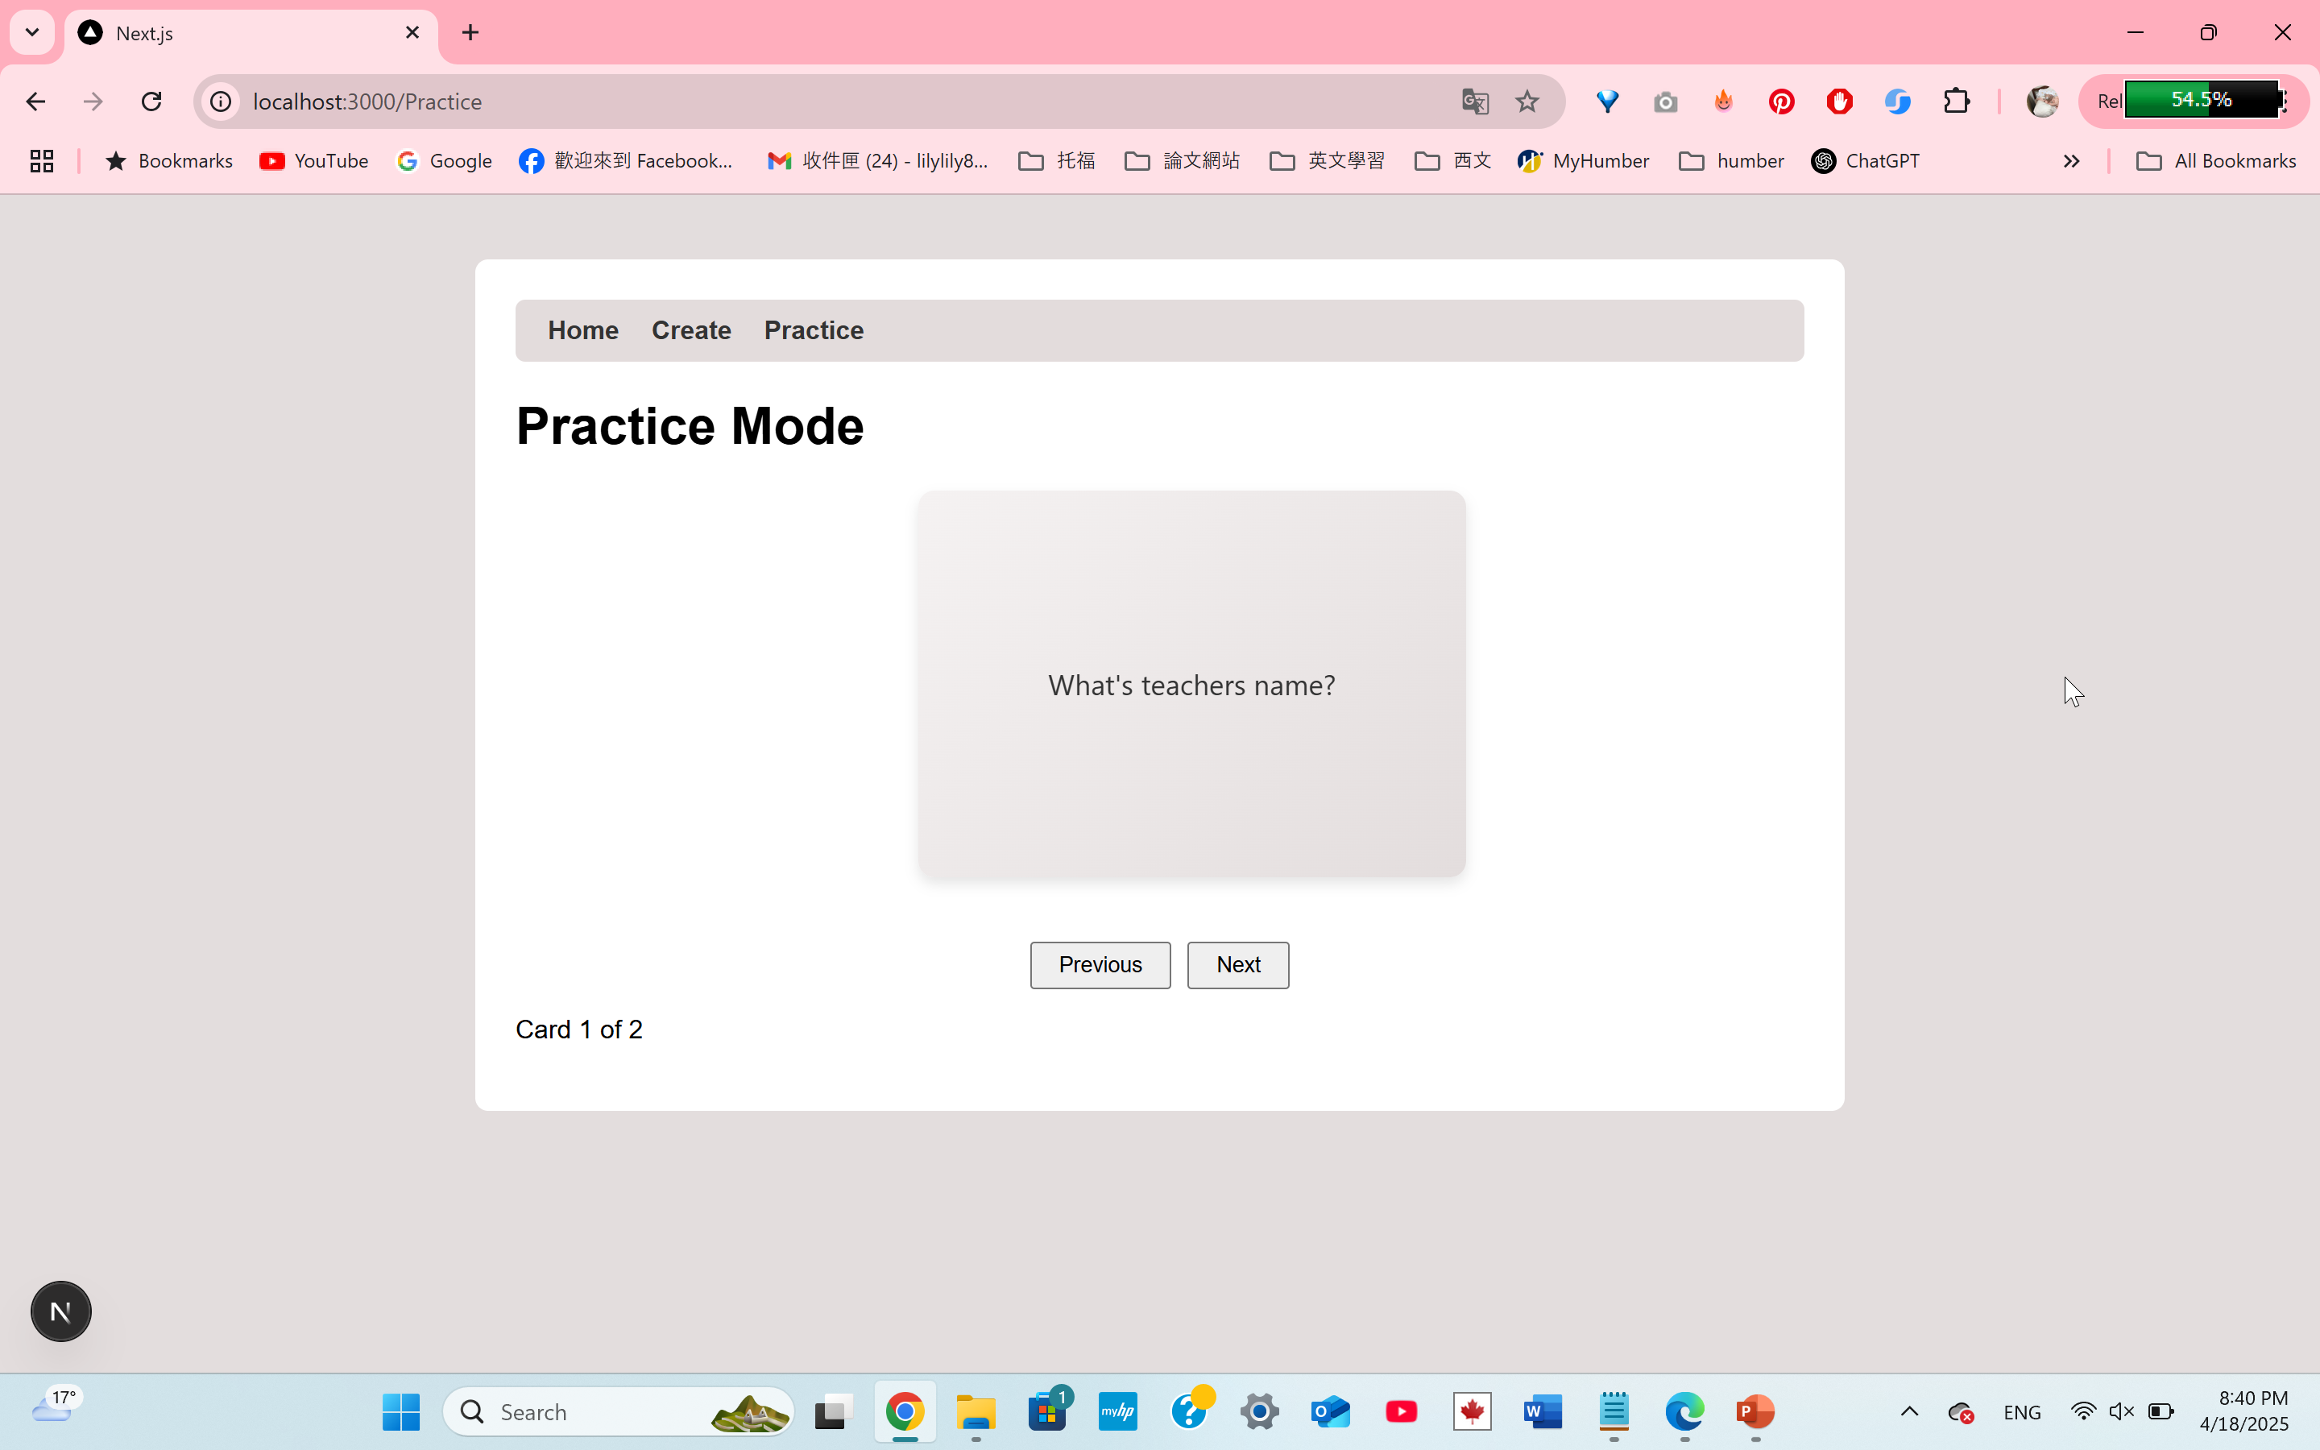
Practice

Slide 9
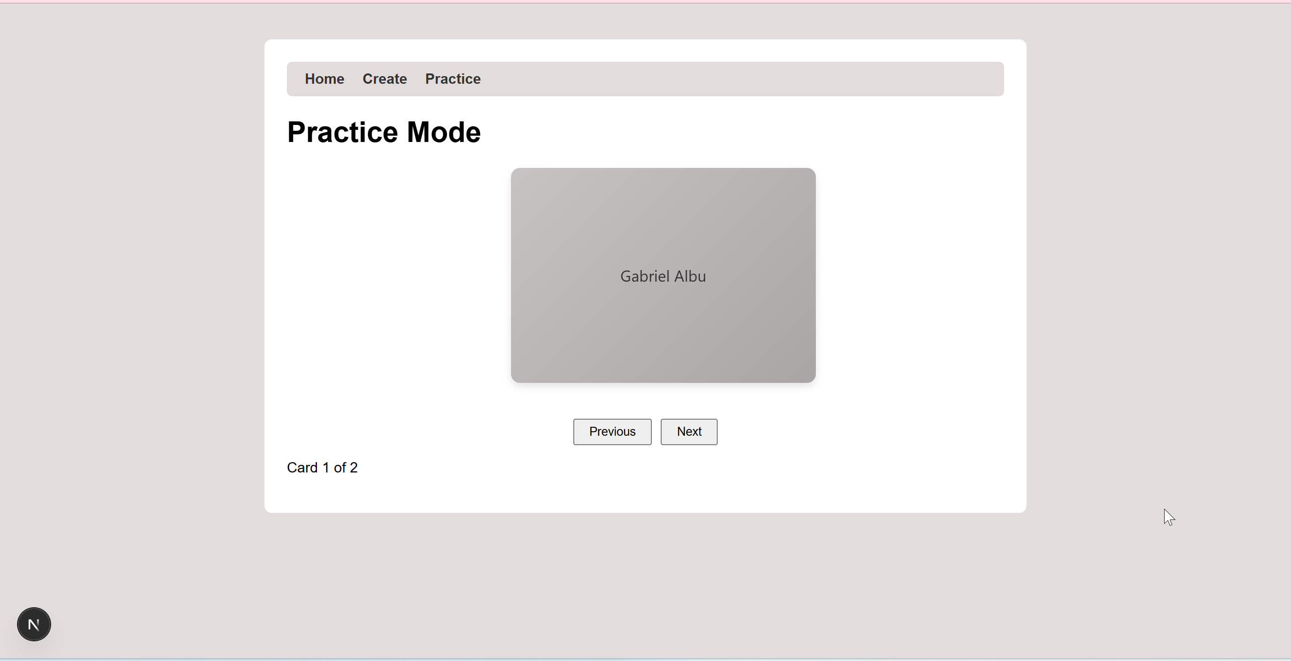
Flipped Flashcard

Slide 10
Summary and Takeaways
- Successfully built a flashcard app using React.
- Learned key skills: state management, component reuse, and storage.
- Solved UI/UX issues through trial, error, and improvement.

